Slide 1

Chapter 4
Digital Transmission
4.<number>
Copyright © The McGraw-Hill Companies, Inc. Permission required for reproduction or display.

Slide 2
4-1 DIGITAL-TO-DIGITAL CONVERSION
In this section, we see how we can represent digital data by using digital signals. The conversion involves three techniques: line coding, block coding, and scrambling. Line coding is always needed; block coding and scrambling may or may not be needed.
Topics discussed in this section:
Line Coding
Line Coding Schemes
Block Coding
Scrambling
4.<number>

Slide 3
Line Coding
Line coding is the process of converting digital data to digital signals. We assume that data, in the form of text, numbers, graphical images, audio, or video, are stored in computer memory as sequences of bits (see Chapter 1). Line coding converts a sequence of bits to a digital signal. At the sender, digital data are encoded into a digital signal; at the receiver, the digital data are recreated by decoding the digital signal.
4.<number>

Slide 4

Figure 4.1 Line coding and decoding
4.<number>

Slide 5
Signal Element Versus Data Element
Let us distinguish between a data element and a signal element. In data communications, our goal is to send data elements. A data element is the smallest entity that can represent a piece of information: this is the bit. In digital data communications, a signal element carries data elements. A signal element is the shortest unit (timewise) of a digital signal. In other words, data elements are what we need to send; signal elements are what we can send. Data elements are being carried; signal elements are the carriers.
4.<number>

Slide 6

Figure 4.2 Signal element versus data element
4.<number>

Slide 7
Data Rate Versus Signal Rate
The data rate defines the number of data elements (bits) sent in 1s. The unit is bits per second (bps). The signal rate is the number of signal elements sent in 1s. The unit is the baud. There are several common terminologies used in the literature. The data rate is sometimes called the bit rate; the signal rate is sometimes called the pulse rate, the modulation rate, or the baud rate.
One goal in data communications is to increase the data rate while decreasing the signal rate. Increasing the data rate increases the speed of transmission; decreasing the signal rate decreases the bandwidth requirement.
4.<number>

Slide 8

Example 4.1
A signal is carrying data in which one data element is encoded as one signal element ( r = 1). If the bit rate is 100 kbps, what is the average value of the baud rate if c is between 0 and 1?
Solution
We assume that the average value of c is 1/2 . The baud rate is then
4.<number>

Slide 9

Note
Although the actual bandwidth of a digital signal is infinite, the effective bandwidth is finite.
4.<number>

Slide 10

Example 4.2
The maximum data rate of a channel (see Chapter 3) is Nmax = 2 × B × log₂ L (defined by the Nyquist formula). Does this agree with the previous formula for N_{max}?
Solution
A signal with L levels actually can carry log₂L bits per level. If each level corresponds to one signal element and we assume the average case (c = 1/2), then we have
4.<number>

Slide 11
Baseline Wandering
In decoding a digital signal, the receiver calculates a running average of the received signal power. This average is called the baseline. The incoming signal power is evaluated against this baseline to determine the value of the data element. A long string of 0s or 1s can cause a drift in the baseline (baseline wandering) and make it difficult for the receiver to decode correctly. A good line coding scheme needs to prevent baseline wandering..
DC Components
When the voltage level in a digital signal is constant for a while, the spectrum creates very low frequencies (results of Fourier analysis). These frequencies around zero, called DC (direct-current) components, present problems for a system that cannot pass low frequencies or a system that uses electrical coupling (via a transformer). We can say that DC component means 0/1 parity that can cause base-line wondering. For example, a telephone line cannot pass frequencies below 200 Hz. Also a long-distance link may use one or more transformers to isolate different parts of the line electrically. For these systems, we need a scheme with no DC component.
4.<number>

Slide 12
Self-synchronization
To correctly interpret the signals received from the sender, the receiver’s bit intervals
must correspond exactly to the sender’s bit intervals. If the receiver clock is faster or
slower, the bit intervals are not matched and the receiver might misinterpret the signals.
Figure 4.3 shows a situation in which the receiver has a shorter bit duration. The sender
sends 10110001, while the receiver receives 110111000011
4.<number>

Slide 13

Figure 4.3 Effect of lack of synchronization
4.<number>

Slide 14
Built-in Error Detection
It is desirable to have a built-in error-detecting capability in the generated code to detect some or all of the errors that occurred during transmission. Some encoding schemes that we will discuss have this capability to some extent.
Immunity to Noise and Interference
Another desirable code characteristic is a code that is immune to noise and other interferences. Some encoding schemes that we will discuss have this capability.
Complexity
A complex scheme is more costly to implement than a simple one. For example, a scheme that uses four signal levels is more difficult to interpret than one that uses only two levels.
4.<number>

Slide 15
Example 4.3
In a digital transmission, the receiver clock is 0.1 percent faster than the sender clock. How many extra bits per second does the receiver receive if the data rate is
1 kbps? How many if the data rate is 1 Mbps?
Solution
At 1 kbps, the receiver receives 1001 bps instead of 1000 bps.
At 1 Mbps, the receiver receives 1,001,000 bps instead of 1,000,000 bps.
4.<number>

Slide 16

Figure 4.4 Line coding schemes
4.<number>

Slide 17
NRZ (Non-Return-to-Zero)
Traditionally, a unipolar scheme was designed as a non-return-to-zero (NRZ) scheme in which the positive voltage defines bit 1 and the zero voltage defines bit 0. It is called NRZ because the signal does not return to zero at the middle of the bit. Figure 4.5 shows a unipolar NRZ scheme. Compared with its polar counterpart (see the next section), this scheme is very costly. As we will see shortly, the normalized power (the power needed to send 1 bit per unit line resistance) is double that for polar NRZ. For this reason, this scheme is normally not used in data communications today.
4.<number>

Slide 18

Figure 4.5 Unipolar NRZ scheme
4.<number>

Slide 19
Polar Schemes
In polar schemes, the voltages are on both sides of the time axis. For example, the voltage level for 0 can be positive and the voltage level for 1 can be negative.
Non-Return-to-Zero (NRZ)
In polar NRZ encoding, we use two levels of voltage amplitude. We can have two versions of polar NRZ: NRZ-L and NRZ-I, as shown in Figure 4.6. The figure also shows the value of r, the average baud rate, and the bandwidth. In the first variation,
NRZ-L
(NRZ-Level), the level of the voltage determines the value of the bit. In the second variation,
NRZ-I (NRZ-Invert), the change or lack of change in the level of the voltage
determines the value of the bit. If there is no change, the bit is 0; if there is a change, the bit is 1.
4.<number>

Slide 20

Figure 4.6 Polar NRZ-L and NRZ-I schemes
4.<number>

Slide 21
Note
In NRZ-L the level of the voltage determines the value of the bit.
In NRZ-I the inversion
or the lack of inversion
determines the value of the bit.
4.<number>

Slide 22
Note
NRZ-L and NRZ-I both have an average signal rate of N/2 Bd.
4.<number>

Slide 23
Note
NRZ-L and NRZ-I both have a DC component problem.
4.<number>

Slide 24
Let us compare these two schemes based on the criteria we previously defined.
Although baseline wandering is a problem for both variations, it is twice as severe in
NRZ-L. If there is a long sequence of 0s or 1s in NRZ-L, the average signal power
becomes skewed. The receiver might have difficulty discerning the bit value. In NRZ-I
this problem occurs only for a long sequence of 0s. If somehow we can eliminate the
long sequence of 0s, we can avoid baseline wandering. We will see shortly how this can
be done.
The synchronization problem (sender and receiver clocks are not synchronized)
also exists in both schemes. Again, this problem is more serious in NRZ-L than in
NRZ-I. While a long sequence of 0s can cause a problem in both schemes, a long
sequence of 1s affects only NRZ-L.
Another problem with NRZ-L occurs when there is a sudden change of polarity in
the system. For example, if twisted-pair cable is the medium, a change in the polarity of
the wire results in all 0s interpreted as 1s and all 1s interpreted as 0s. NRZ-I does not
have this problem. Both schemes have an average signal rate of N/2 Bd.
4.<number>

Slide 25
Example 4.4
A system is using NRZ-I to transfer 10-Mbps data. What are the average signal rate and minimum bandwidth?
Solution
The average signal rate is S = N/2 = 500 kbaud. The minimum bandwidth for this average baud rate is Bmin = S = 500 kHz.
4.<number>

Slide 26
Return-to-Zero (RZ)
The main problem with NRZ encoding occurs when the sender and receiver clocks are not synchronized. The receiver does not know when one bit has ended and the next bit is starting. One solution is the return-to-zero (RZ) scheme, which uses three values: positive, negative, and zero. In RZ, the signal changes not between bits but during the bit. In Figure 4.7 we see that the signal goes to 0 in the middle of each bit. It remains there until the beginning of the next bit. The main disadvantage of RZ encoding is that it requires two signal changes to encode a bit and therefore occupies greater bandwidth.
The same problem we mentioned, a sudden change of polarity resulting in all 0s interpreted as 1s and all 1s interpreted as 0s, still exists here, but there is no DC component problem. Another problem is the complexity: RZ uses three levels of voltage, which is more complex to create and discern. As a result of all these deficiencies, the scheme is not used today. Instead, it has been replaced by the better-performing Manchester and differential Manchester schemes
4.<number>

Slide 27

Figure 4.7 Polar RZ scheme
4.<number>

Slide 28

Figure 4.8 Polar biphase: Manchester and differential Manchester schemes
4.<number>

Slide 29
Biphase: Manchester and Differential Manchester
The idea of RZ (transition at the middle of the bit) and the idea of NRZ-L are combined into the Manchester scheme. In Manchester encoding, the duration of the bit is divided into two halves. The voltage remains at one level during the first half and moves to the other level in the second half. The transition at the middle of the bit provides synchronization.
Differential Manchester, on the other hand, combines the ideas of RZ and
NRZ-I. There is always a transition at the middle of the bit, but the bit values are determined at the beginning of the bit. If the next bit is 0, there is a transition; if the next bit is 1, there is none. Figure 4.8 shows both Manchester and differential Manchester encoding. The Manchester scheme overcomes several problems associated with NRZ-L, and differential Manchester overcomes several problems associated with NRZ-I.
4.<number>

Slide 30
First, there is no baseline wandering. There is no DC component because each bit has a positive and negative voltage contribution. The only drawback is the signal rate. The signal rate for Manchester and differential Manchester is double that for NRZ. The reason is that there is always one transition at the middle of the bit and maybe one transition at the end of each bit. Figure 4.8 shows both Manchester and differential Manchester encoding schemes. Note that Manchester and differential Manchester schemes are also called biphase schemes.
4.<number>

Slide 31
Note
In Manchester and differential Manchester encoding, the transition
at the middle of the bit is used for synchronization.
4.<number>

Slide 32
Note
The minimum bandwidth of Manchester and differential Manchester is 2 times that of NRZ.
4.<number>

Slide 33
Note
In bipolar encoding, we use three levels: positive, zero, and negative.
4.<number>

Slide 34

Figure 4.9 Bipolar schemes: AMI and pseudoternary
4.<number>

Slide 35
Note
In mBnL schemes, a pattern of m data elements is encoded as a pattern of n signal elements in which 2^{m} ≤ L^{n}.
4.<number>

Slide 36

Figure 4.10 Multilevel: 2B1Q scheme
4.<number>

Slide 37

Figure 4.11 Multilevel: 8B6T scheme
4.<number>

Slide 38

Figure 4.12 Multilevel: 4D-PAM5 scheme
4.<number>

Slide 39

Figure 4.13 Multitransition: MLT-3 scheme
4.<number>

Slide 40


Table 4.1 Summary of line coding schemes
4.<number>

Slide 41
Note
Block coding is normally referred to as mB/nB coding;
it replaces each m-bit group with an
n-bit group.
4.<number>

Slide 42

Figure 4.14 Block coding concept
4.<number>

Slide 43

Figure 4.15 Using block coding 4B/5B with NRZ-I line coding scheme
4.<number>

Slide 44


Table 4.2 4B/5B mapping codes
4.<number>

Slide 45

Figure 4.16 Substitution in 4B/5B block coding
4.<number>

Slide 46
Example 4.5
We need to send data at a 1-Mbps rate. What is the minimum required bandwidth, using a combination of 4B/5B and NRZ-I or Manchester coding?
Solution
First 4B/5B block coding increases the bit rate to 1.25 Mbps. The minimum bandwidth using NRZ-I is N/2 or 625 kHz. The Manchester scheme needs a minimum bandwidth of 1 MHz. The first choice needs a lower bandwidth, but has a DC component problem; the second choice needs a higher bandwidth, but does not have a DC component problem.
4.<number>

Slide 47

Figure 4.17 8B/10B block encoding
4.<number>

Slide 48

Figure 4.18 AMI used with scrambling
4.<number>

Slide 49

Figure 4.19 Two cases of B8ZS scrambling technique
4.<number>

Slide 50
Note
B8ZS substitutes eight consecutive zeros with 000VB0VB.
4.<number>

Slide 51

Figure 4.20 Different situations in HDB3 scrambling technique
4.<number>

Slide 52
Note
HDB3 substitutes four consecutive zeros with 000V or B00V depending
on the number of nonzero pulses after the last substitution.
4.<number>

Slide 53
4-2 ANALOG-TO-DIGITAL CONVERSION
We have seen in Chapter 3 that a digital signal is superior to an analog signal. The tendency today is to change an analog signal to digital data. In this section we describe two techniques, pulse code modulation and delta modulation.
Topics discussed in this section:
Pulse Code Modulation (PCM)
Delta Modulation (DM)
4.<number>

Slide 54
4.2.1 Pulse Code Modulation (PCM)
The most common technique to change an analog signal to digital data (digitization) is called pulse code modulation (PCM). A PCM encoder has three processes
1. The analog signal is sampled.
2. The sampled signal is quantized.
3. The quantized values are encoded as streams of bits.
4.<number>

Slide 55

Figure 4.21 Components of PCM encoder
4.<number>

Slide 56
Sampling
The first step in PCM is sampling. The analog signal is sampled every Ts s, where Ts is the sample interval or period. The inverse of the sampling interval is called the sampling rate or sampling frequency and denoted by fs, where fs = 1/Ts. There are three sampling methods—
ideal, natural, and flat-top
In ideal sampling, pulses from the analog signal are sampled. This is an ideal sampling method and cannot be easily implemented. In natural sampling, a high-speed switch is turned on for only the small period of time when the sampling occurs. The result is a sequence of samples that retains the shape of the analog signal. The most common sampling method, called sample and hold, however, creates flat-top samples by using a circuit.
The sampling process is sometimes referred to as pulse amplitude modulation (PAM). We need to remember, however, that the result is still an analog signal with nonintegral values.
4.<number>

Slide 57

Figure 4.22 Three different sampling methods for PCM
4.<number>

Slide 58
Sampling Rate
One important consideration is the sampling rate or frequency.
Note
According to the Nyquist theorem, the sampling rate must be
at least 2 times the highest frequency contained in the signal.
4.<number>

Slide 59

Figure 4.23 Nyquist sampling rate for low-pass and bandpass signals
4.<number>

Slide 60
Example 4.6
For an intuitive example of the Nyquist theorem, let us sample a simple sine wave at three sampling rates: f_{s} = 4f (2 times the Nyquist rate), f_{s} = 2f (Nyquist rate), and
f_{s} = f (one-half the Nyquist rate). Figure 4.24 shows the sampling and the subsequent recovery of the signal.
It can be seen that sampling at the Nyquist rate can create a good approximation of the original sine wave (part a). Oversampling in part b can also create the same approximation, but it is redundant and unnecessary. Sampling below the Nyquist rate (part c) does not produce a signal that looks like the original sine wave.
4.<number>

Slide 61

Figure 4.24 Recovery of a sampled sine wave for different sampling rates
4.<number>

Slide 62
Example 4.7
Consider the revolution of a hand of a clock. The second hand of a clock has a period of 60 s. According to the Nyquist theorem, we need to sample the hand every 30 s (T_{s} = T or f_{s} = 2f ). In Figure 4.25a, the sample points, in order, are 12, 6, 12, 6, 12, and 6. The receiver of the samples cannot tell if the clock is moving forward or backward. In part b, we sample at double the Nyquist rate (every 15 s). The sample points are 12, 3, 6, 9, and 12. The clock is moving forward. In part c, we sample below the Nyquist rate (T_{s} = T or f_{s} = f ). The sample points are 12, 9, 6, 3, and 12. Although the clock is moving forward, the receiver thinks that the clock is moving backward.
4.<number>

Slide 63

Figure 4.25 Sampling of a clock with only one hand
4.<number>

Slide 64
Example 4.8
An example related to Example 4.7 is the seemingly backward rotation of the wheels of a forward-moving car in a movie. This can be explained by under-sampling. A movie is filmed at 24 frames per second. If a wheel is rotating more than 12 times per second, the under-sampling creates the impression of a backward rotation.
4.<number>

Slide 65
Example 4.9
Telephone companies digitize voice by assuming a maximum frequency of 4000 Hz. The sampling rate therefore is 8000 samples per second.
4.<number>

Slide 66
Example 4.10
A complex low-pass signal has a bandwidth of 200 kHz. What is the minimum sampling rate for this signal?
Solution
The bandwidth of a low-pass signal is between 0 and f, where f is the maximum frequency in the signal. Therefore, we can sample this signal at 2 times the highest frequency (200 kHz). The sampling rate is therefore 400,000 samples per second.
4.<number>

Slide 67
Example 4.11
A complex bandpass signal has a bandwidth of 200 kHz. What is the minimum sampling rate for this signal?
Solution
We cannot find the minimum sampling rate in this case because we do not know where the bandwidth starts or ends. We do not know the maximum frequency in the signal.
4.<number>

Slide 68
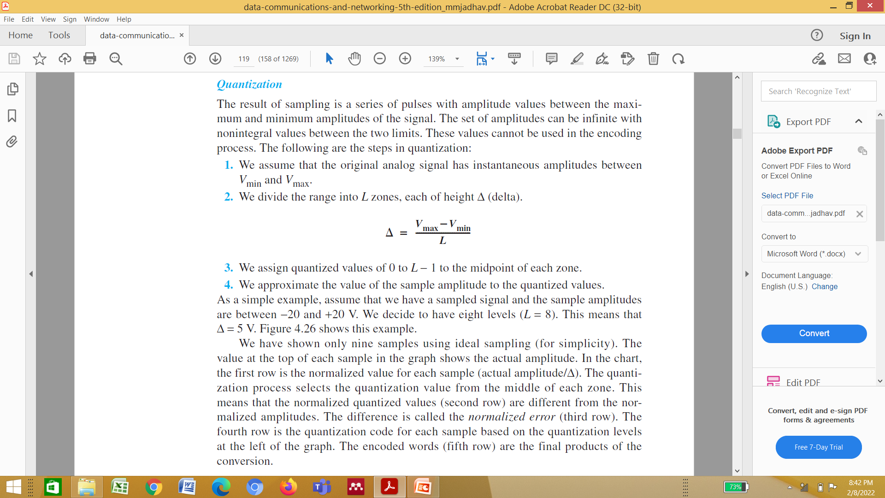
4.<number>

Slide 69
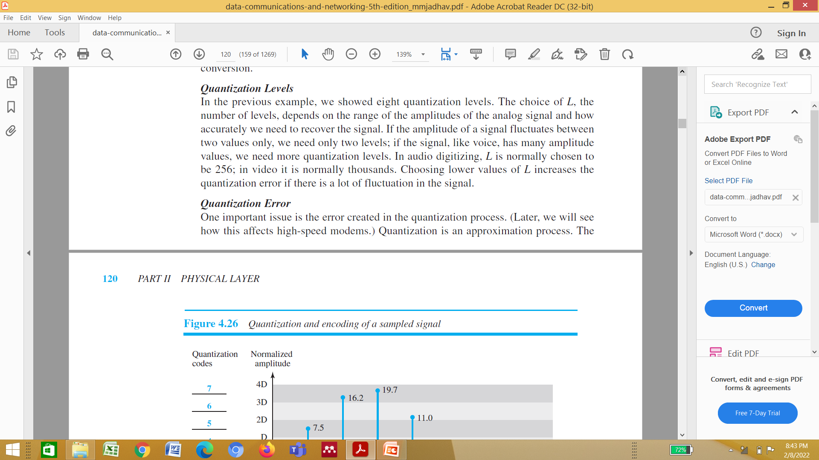
4.<number>

Slide 70

Figure 4.26 Quantization and encoding of a sampled signal
4.<number>

Slide 71
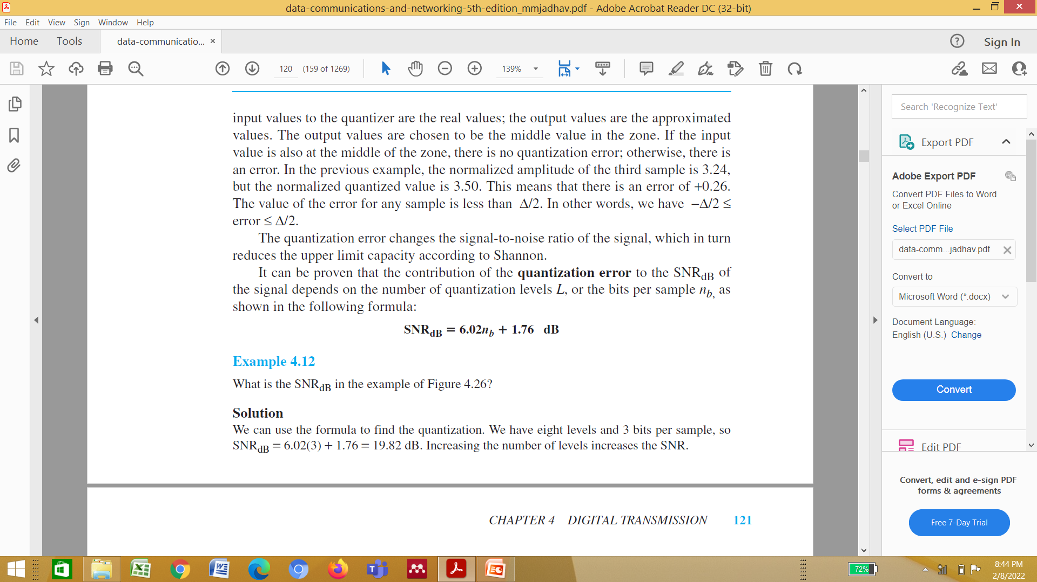
4.<number>

Slide 72
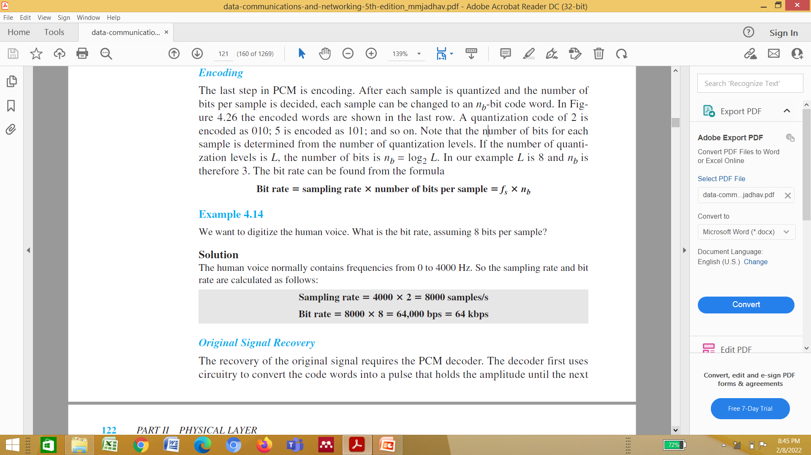
4.<number>

Slide 73
Example 4.12
What is the SNRdB in the example of Figure 4.26?
Solution
We can use the formula to find the quantization. We have eight levels and 3 bits per sample, so
SNRdB = 6.02(3) + 1.76 = 19.82 dB
Increasing the number of levels increases the SNR.
4.<number>

Slide 74
Example 4.13
A telephone subscriber line must have an SNRdB above 40. What is the minimum number of bits per sample?
Solution
We can calculate the number of bits as
Telephone companies usually assign 7 or 8 bits per sample.
4.<number>

Slide 75

Example 4.14
We want to digitize the human voice. What is the bit rate, assuming 8 bits per sample?
Solution
The human voice normally contains frequencies from 0 to 4000 Hz. So the sampling rate and bit rate are calculated as follows:
4.<number>

Slide 76

Figure 4.27 Components of a PCM decoder
4.<number>

Slide 77
Example 4.15
We have a low-pass analog signal of 4 kHz. If we send the analog signal, we need a channel with a minimum bandwidth of 4 kHz. If we digitize the signal and send 8 bits per sample, we need a channel with a minimum bandwidth of 8 × 4 kHz = 32 kHz.
4.<number>

Slide 78
Delta Modulation (DM)
PCM is a very complex technique. Other techniques have been developed to reduce the complexity of PCM. The simplest is delta modulation. PCM finds the value of the signal amplitude for each sample; DM finds the change from the previous sample. Figure 4.28 shows the process. Note that there are no code words here; bits are sent one after another.
4.<number>

Slide 79

Figure 4.28 The process of delta modulation
4.<number>

Slide 80
Modulator
The modulator is used at the sender site to create a stream of bits from an analog signal. The process records the small positive or negative changes, called delta δ. If the delta is positive, the process records a 1; if it is negative, the process records a 0. However, the process needs a base against which the analog signal is compared. The modulator builds a second signal that resembles a staircase. Finding the change is then reduced to comparing the input signal with the gradually made staircase signal. Figure 4.29 shows a diagram of the process.
4.<number>

Slide 81

Figure 4.29 Delta modulation components
4.<number>

Slide 82

Figure 4.30 Delta demodulation components
4.<number>

Slide 83
The modulator, at each sampling interval, compares the value of the analog signal
with the last value of the staircase signal. If the amplitude of the analog signal is
larger, the next bit in the digital data is 1; otherwise, it is 0. The output of the comparator,
however, also makes the staircase itself. If the next bit is 1, the staircase maker
moves the last point of the staircase signal δ up; if the next bit is 0, it moves it δ down.
Note that we need a delay unit to hold the staircase function for a period between two
comparisons.
Demodulator
The demodulator takes the digital data and, using the staircase maker and the
delay unit, creates the analog signal. The created analog signal, however, needs to
pass through a low-pass filter for smoothing. Figure 4.30 shows the schematic
diagram.
4.<number>

Slide 84
4-3 TRANSMISSION MODES
The transmission of binary data across a link can be accomplished in either parallel or serial mode. In parallel mode, multiple bits are sent with each clock tick. In serial mode, 1 bit is sent with each clock tick. While there is only one way to send parallel data, there are three subclasses of serial transmission: asynchronous, synchronous, and isochronous.
Topics discussed in this section:
Parallel Transmission
Serial Transmission
4.<number>

Slide 85

Figure 4.31 Data transmission and modes
4.<number>

Slide 86

Figure 4.32 Parallel transmission
4.<number>

Slide 87

Figure 4.33 Serial transmission
4.<number>

Slide 88
Note
In asynchronous transmission, we send 1 start bit (0) at the beginning and 1 or more stop bits (1s) at the end of each byte. There may be a gap between
each byte.
4.<number>

Slide 89
Note
Asynchronous here means “asynchronous at the byte level,”
but the bits are still synchronized;
their durations are the same.
4.<number>

Slide 90

Figure 4.34 Asynchronous transmission
4.<number>

Slide 91
Note
In synchronous transmission, we send bits one after another without start or stop bits or gaps. It is the responsibility of the receiver to group the bits.
4.<number>

Slide 92

Figure 4.35 Synchronous transmission
4.<number>

